Slide 1
Nuevos retos del seguro agropecuario: masividad y tecnologías disruptivas

Slide 2

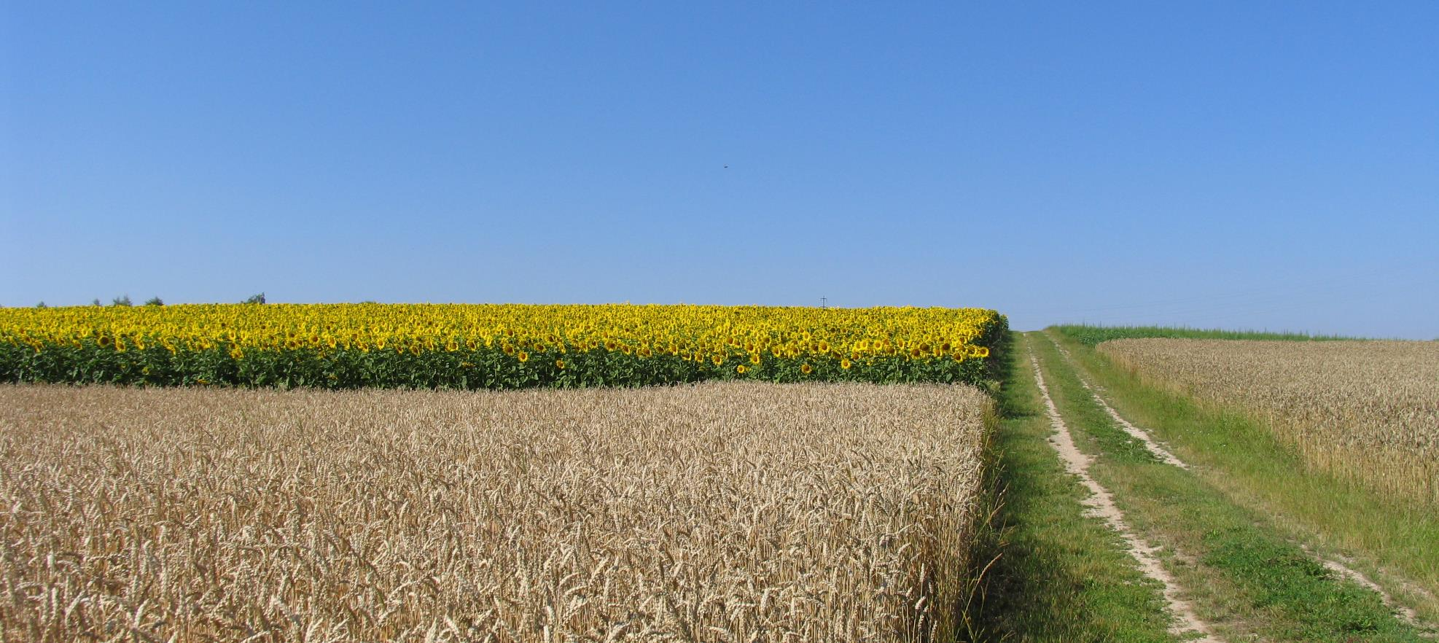
International Trends in
Agro Risk Management
A view from Europe
XVI CONGRESO INTERNACIONAL ALASA

Slide 3
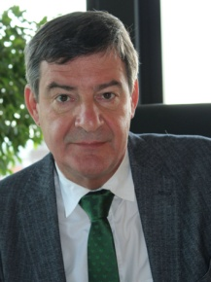
Dr. Rainer Langner – Vita
Born July 28th 1956
Married, 2 children
Grew up on a farm in Lower Saxony (district Cloppenburg)
Studied Agricultural Science at the Christian-Albrecht University in Kiel
Obtainment of a doctorate
Since October 1985 at the Norddeutsche Hagelversicherung
Since 1991 Member of the Board
Since June 1st 1996 CEO of the Vereinigte Hagelversicherung, a mutual company and the leading insurance company in Germany and other countries
ASSOCIATION INTERNATIONALE DES ASSUREURS DE LA PRODUCTION AGRICOLE
ASSOCIAZIONE INTERNAZIONALE DEGLI ASSICURATORI DELLA PRODUZIONE AGRICOLA
3

Slide 4
Dr. Rainer Langner – Vita
Since 2008 Chairman of the Expert Network Agriculture in the German Insurance Association (formerly: Commission Agriculture)
Since 2003 Chairman of the Working Group of German Plant Insurers in the German Insurance Association
Since 2003 Member of the Presiding Committee of AIAG
(International Association of Insurers of the agricultural production)
- from 2007-2011 AIAG President –
Since 2014 Deputy Chairman of the DLG Working Group-banks and insurance Companies
ASSOCIATION INTERNATIONALE DES ASSUREURS DE LA PRODUCTION AGRICOLE
ASSOCIAZIONE INTERNAZIONALE DEGLI ASSICURATORI DELLA PRODUZIONE AGRICOLA
4

Slide 5


Vereinigte Hagel – History Dates Back to 1824
1993 VEREINIGTE HAGEL was founded
through a merger of “Leipziger Hagel” (1824)
and “Norddeutsche Hagel” (1869)
The legal form of VEREINIGTE HAGEL:
Mutual Insurance Company
ASSOCIATION INTERNATIONALE DES ASSUREURS DE LA PRODUCTION AGRICOLE
ASSOCIAZIONE INTERNAZIONALE DEGLI ASSICURATORI DELLA PRODUZIONE AGRICOLA
5

Slide 6
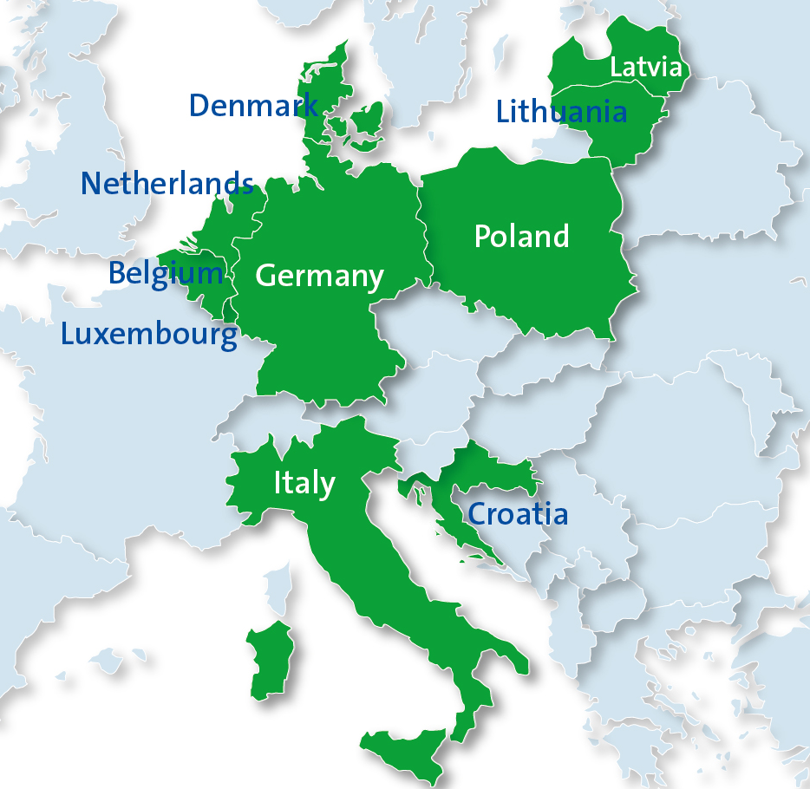
2008
2012
VEREINIGTE HAGEL – Europe‘s crop insurer
2007
2008
2012
1999
1993
2017
→ total premium 2019: 220 million €
2005 (service business since 2002)
ASSOCIATION INTERNATIONALE DES ASSUREURS DE LA PRODUCTION AGRICOLE
ASSOCIAZIONE INTERNAZIONALE DEGLI ASSICURATORI DELLA PRODUZIONE AGRICOLA
6

Slide 7
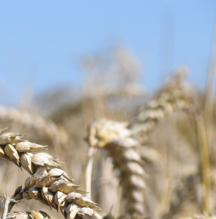
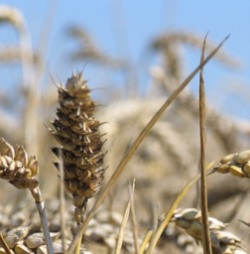
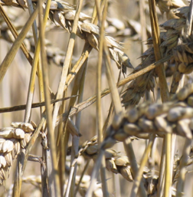
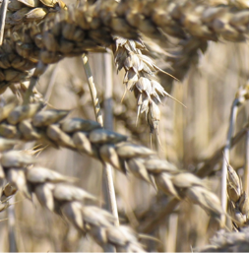

INTERNATIONAL ASSOCIATION OF AGRICULTURAL PRODUCTION INSURERS
INTERNATIONALE VEREINIGUNG DER VERSICHERER DER LANDWIRTSCHAFTLICHEN PRODUKTION
The AIAG was founded in 1951 in Paris. Currently more than 100 companies from 30 countries are members of the Association.
The Association's key objectives are:
to organize an international congress every two years in a different country
to exchange worldwide experiences and to study current challenges.
to organize an international adjuster’s seminar every year in a different country and on a different crop to get in touch with various loss adjustment guidelines and directives («Loss Adjusters’ Committee»).
regular exchange of experience in the area of Livestock Insurance with an own working group («Working Group Livestock Insurance»).
to organize study trips to get to know new Crop Insurance Systems.
to create cooperative relationships and connections between members.
to stay in contact with other Crop Insurance Associations to inform members about different insurance systems.
AIAG web site: http://www.aiag-iahi.org/
ASSOCIATION INTERNATIONALE DES ASSUREURS DE LA PRODUCTION AGRICOLE
ASSOCIAZIONE INTERNAZIONALE DEGLI ASSICURATORI DELLA PRODUZIONE AGRICOLA
7

Slide 8
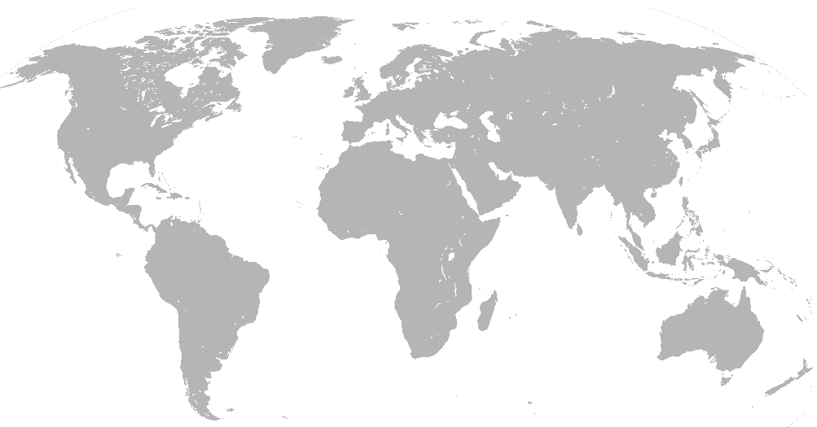

European Agro Insurance Market - Size
EUROPE Agro Insurance Premium 2.5 Billion EUR
 |  |  |  | in MEUR
1 | Spain |  |  | 740
2 | Italy |  |  | 510
3 | France |  |  | 500

Slide 9
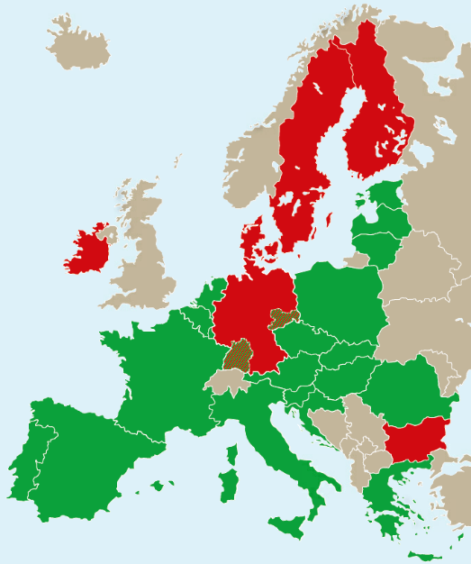

European Agro Insurance Market – Subsidy schemes
EU plus national funding or only national funding
Subsidies only for special risks and crops
No subsidies

Slide 10
European Agricultural Structure – Subsidy level
maximum premium subsidy
field crops
fruit
grapes
Belgium
65%
65%
65%
Italy
65-70%
65-70%
65-70%
Croatia
70%
70%
70%
Netherlands
65%
65%
65%
Latvia
70%
70%
70%
Lithuania
70%
70%
70%
Luxembourg
65%
65%
65%
Austria
55%
55%
55%
Poland
65%
65%
65%
Romania
55-70%
55-70%
50-80%
Slovakia
40-45%
40-45%
50%
Slovenia
50%
50%
50%
Czech Rep.
10-50%
35-65%
35-65%
Hungary
45-65%
45-65%
45-65%

Slide 11
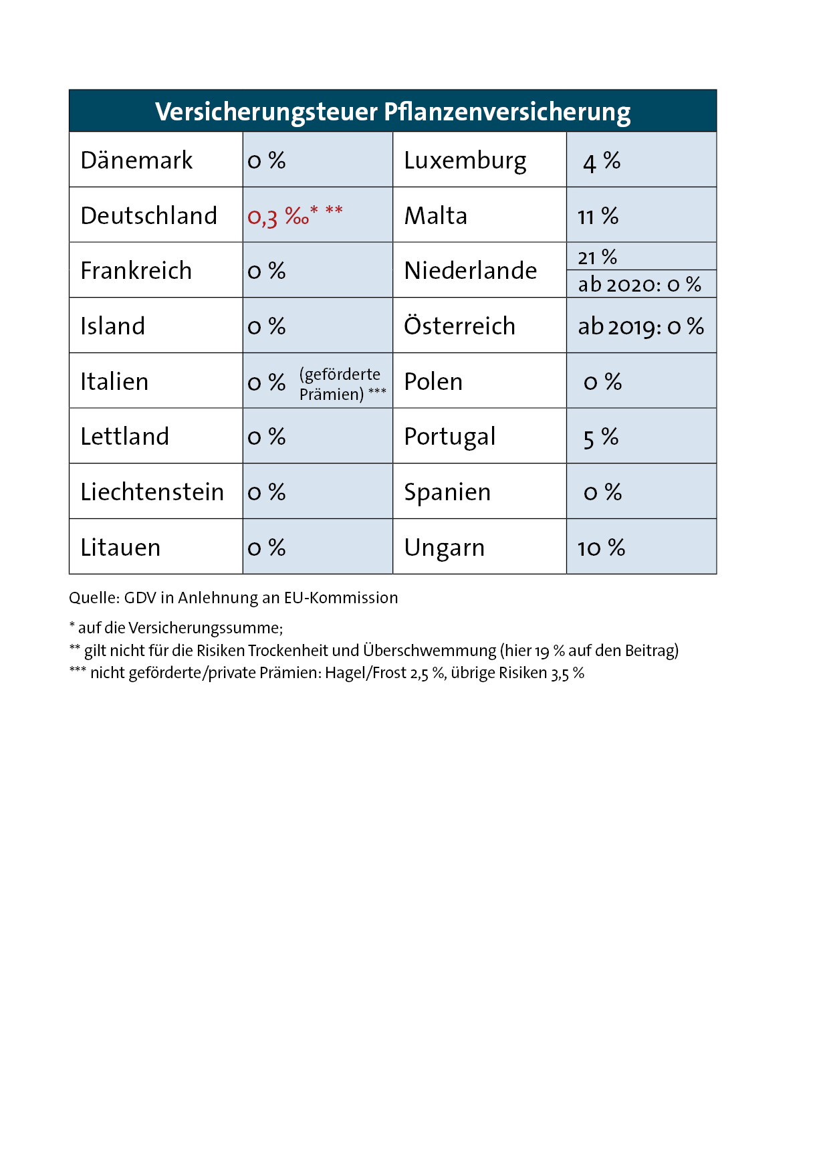
European Agricultural Structure
Different insurance premium tax rates
crop insurance tax
Denmark
Luxembourg
Germany
Malta
France
Netherlands
Iceland
Austria
Italy
(subsidized insurance)
Poland
Latvia
Portugal
Liechtenstein
Spain
Lithuania
Hungary
* of the sum insured

Slide 12
European Agriculture - Specificities and Challenges
Some specificities of the European agriculture
Very diversified agricultural production
Partly historically grown structures
Heterogenous farm structures within European countries
Existence of the Common agricultural Policy CAP, which takes action through the following instruments:
- income support through direct payments
- market measures to deal with difficult market situations
- rural development measures with national and regional programs
Some of the challenges of the European agriculture
Partly not cost-covering prices for agricultural products
Global warming
Appearance of new crop insects, diseases (globalization and/or global warming)
Land consumption, land loss due to ongoing construction activities
Increasing public awareness of potential problems related to pesticides (health, drinking water quality, etc.)

Slide 13
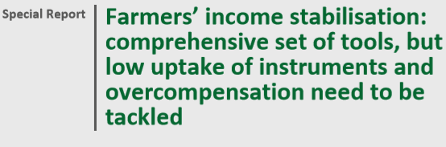

- Lessons learnt
Insurance allows farmers to take risks - Insurance makes risks calculable and acceptable

Slide 14
European Agro Insurance Industry
Facts and Challenges
Mostly mature markets (hail insurance exists for more than 180 years)
Presence of many specialized agricultural insurers and reinsurers with extensive experience and know-how
Mostly named Peril and/or MPCI insurance products are offered
Still very few indices, parametric solutions (market share in the low single-digit percentage range, some not eligible for premium subsidies)
Availability of well-trained claims experts in sufficient numbers
Sometimes very complex - time and cost-intensive specifications and controls in connection with the premium subsidy
The size of the continent, and even more of the individual countries can make it difficult to balance risks, especially for systemic risks (e.g. frost, drought, see next slide)

Slide 15
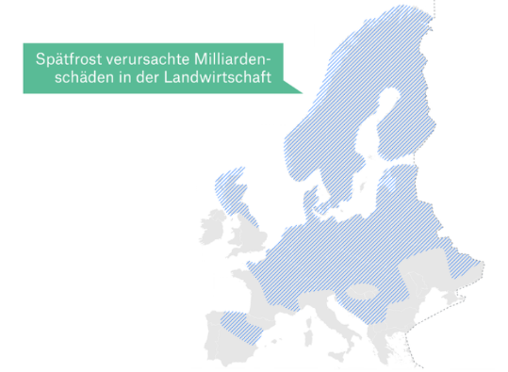
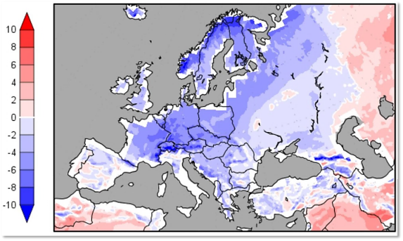

Spring Frost in Europe 2017
Late frost caused billions of euros damage in the agricultural sector
Ref. Munich Re

Slide 16
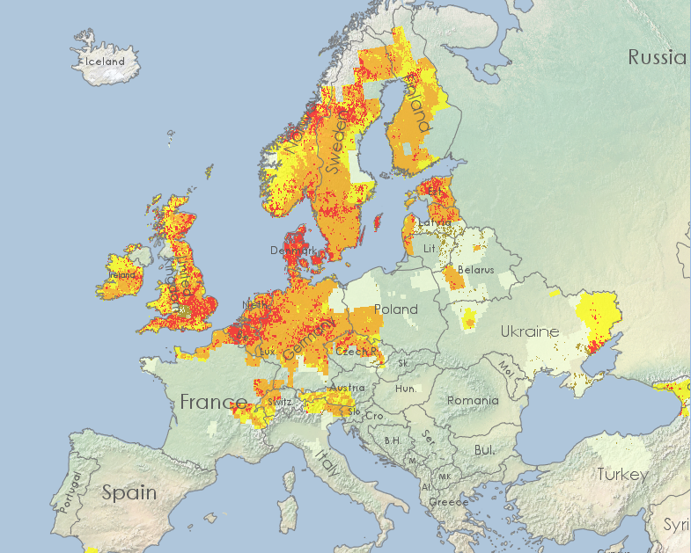
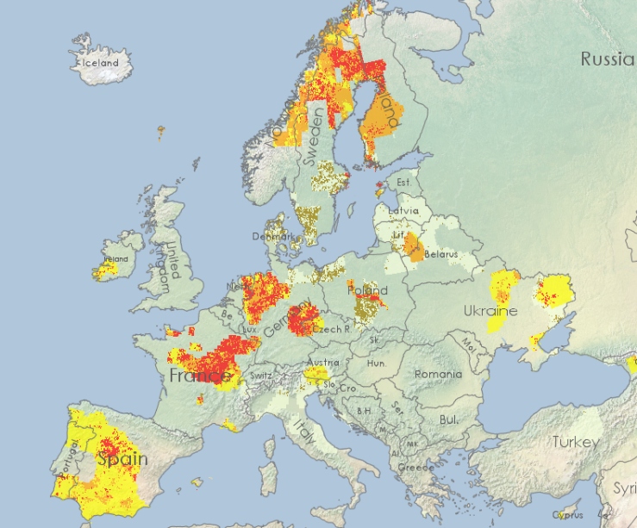

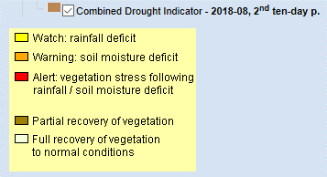
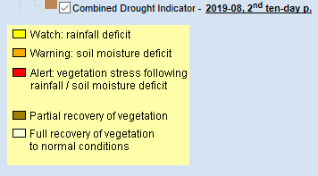
Drought in Europe 2018 and 2019
2018
2019

Slide 17
New Technologies
… enable to
integrate, optimize and rationalize processes even more
(time and cost optimization)
have digital contact, communication with the insured farmers
collect huge data for Agro Insurance through satellites, threats, radar, ground stations, agricultural equipment, etc. to evaluate and analyze:
- field boundaries
- temperature, precipitation, soil moisture
- crop type
- vegetation growth, harvest time
- damage/yield loss
➔ New era in data collection, quality and analysis!

Slide 18
New Technologies
… this new era in data collection and quality
can be used for
Product development, simulation
Insurance acceptance, risk analysis
Risk prevention
Operational planning and supervision of damage estimation
Damage detection, loss estimation (yield estimation)
Fraud detection

Slide 19
Examples

Slide 20
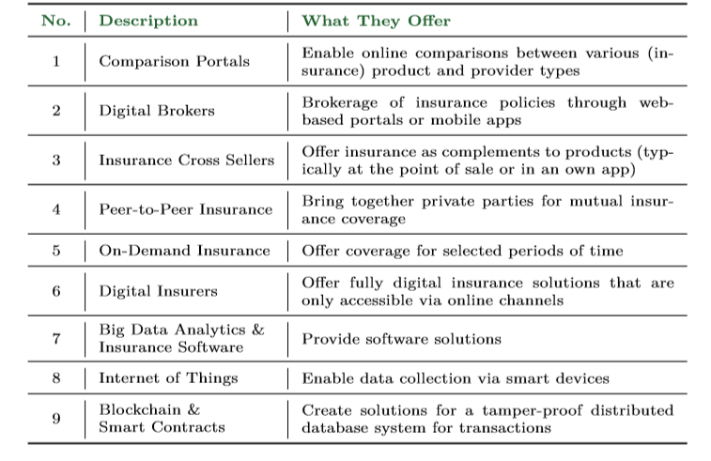
Insuretech
… what is an insuretech?
attempt to make a categorization …
Ref. Alexander Braun, Florian Schreiber IVW
agro insurance
applications
10 ¦ Provider of: data, data analysis (weather data incl. NDVI, field/harvest data, etc.),
¦ damage detection, loss assessment or of ready index, parametric solutions

Slide 21
Insuretech
… facts, outlook
            In Europe there are very few insuretech that offer agro insurance solutions - mostly, if at all, index solutions.
            However, there are some agile start-ups that offer targeted services in the field of new technologies (analysis of satellite/radar data, geolocation, big data, etc.). They often work together with insurers, reinsurers, universities or supranational organizations.
            A certain braking factor for new developments is certainly that the insurance industry is a highly regulated industry - this with the intention of ensuring the safety of the policyholders.

